Slide 1
THE BATTLE OF NEIGHBORHOODS
IBM Data Science Program – Capstone Project
Jairo Ivan Ordoñez
December 2019

Slide 2
BUSINESS PROBLEM
A Colombian freelancer is looking for a Neighborhood to live in Cartagena or Bogotá, however, he needs these special facilities:
Vegetarian or Vegan Restaurant, because He cannot eat animal protein (meat, fish, chicken, etc.)
A gym or Public Park to make physic exercise.
Farmer market to buy the vegetables and fruit for his diet.
Pharmacy to buy medicament to his allergy
The Colombian ask to help for us to, with cluster models applied in the Data Science Program, we can recommend him the Neighborhoods than accommodate to his requests.
Note: We will not evaluate the security or living price in the Neighborhoods, only the closer venues.

Slide 3
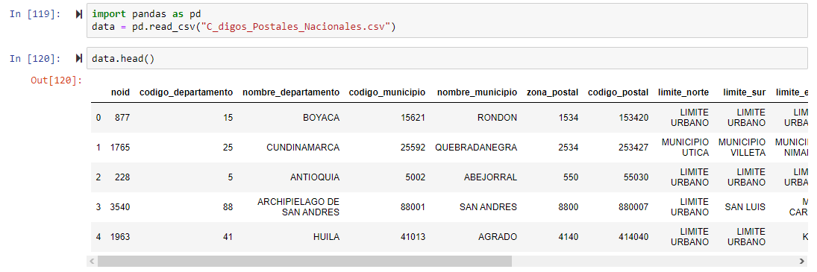
DATA

Slide 4
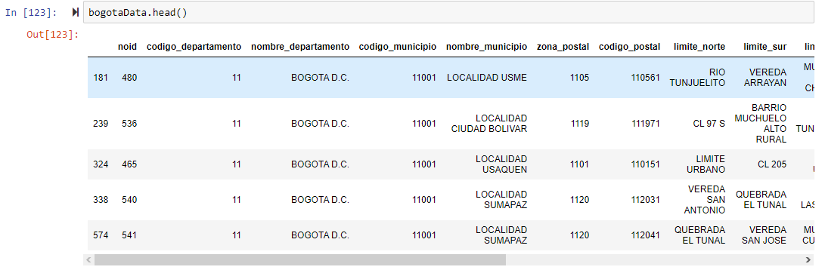
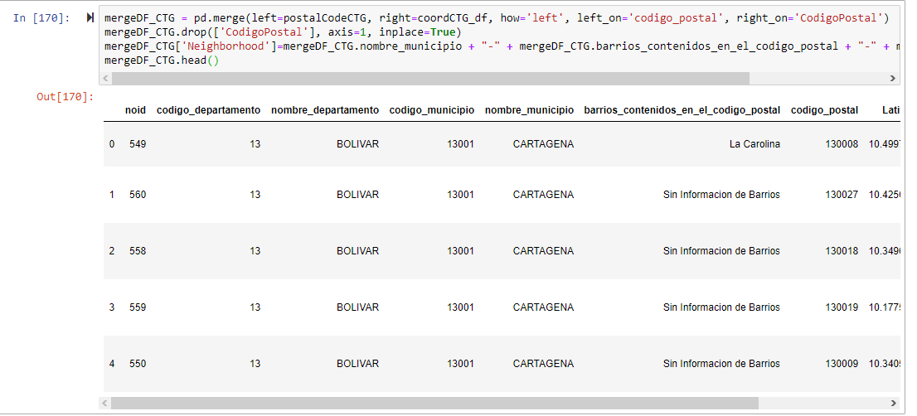
DATA
BOGOTA
CARTAGENA

Slide 5
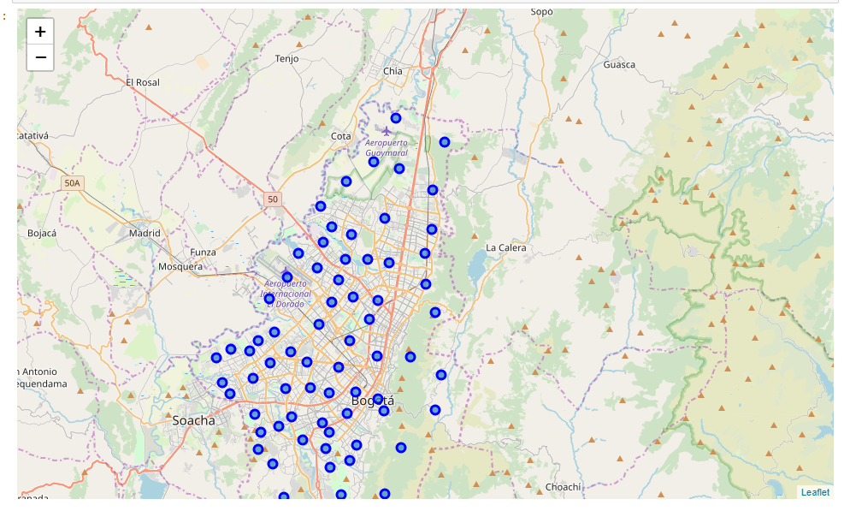
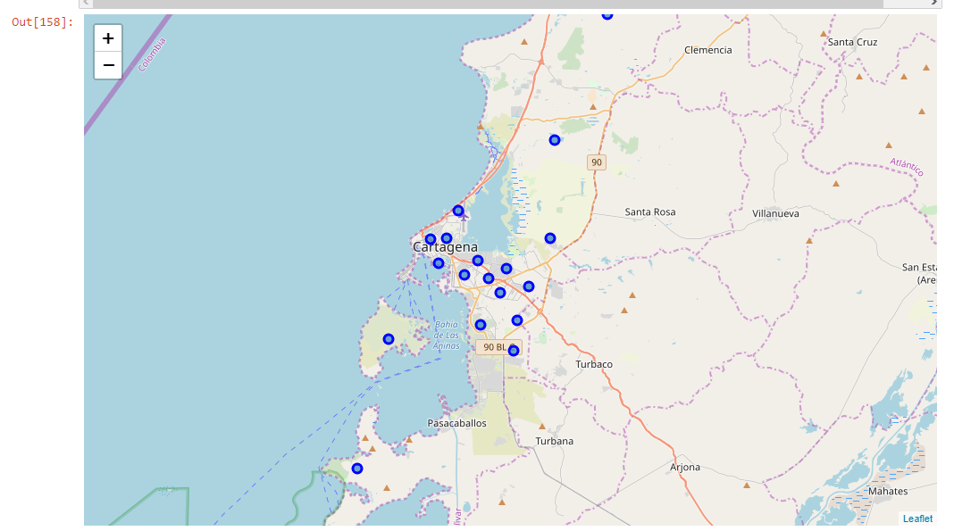
RESULT MAPS
BOGOTA
CARTAGENA

Slide 6
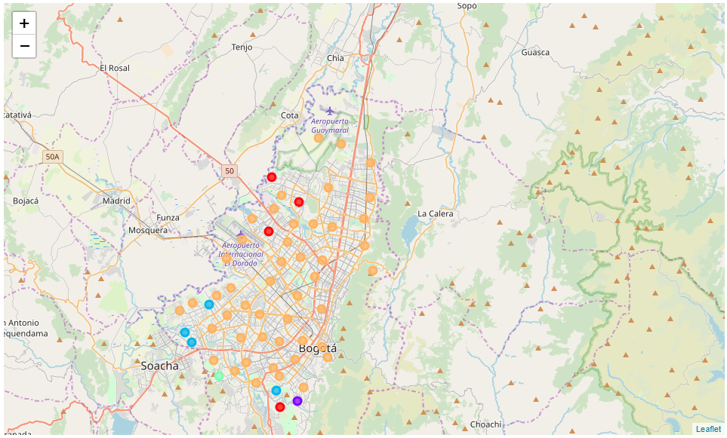
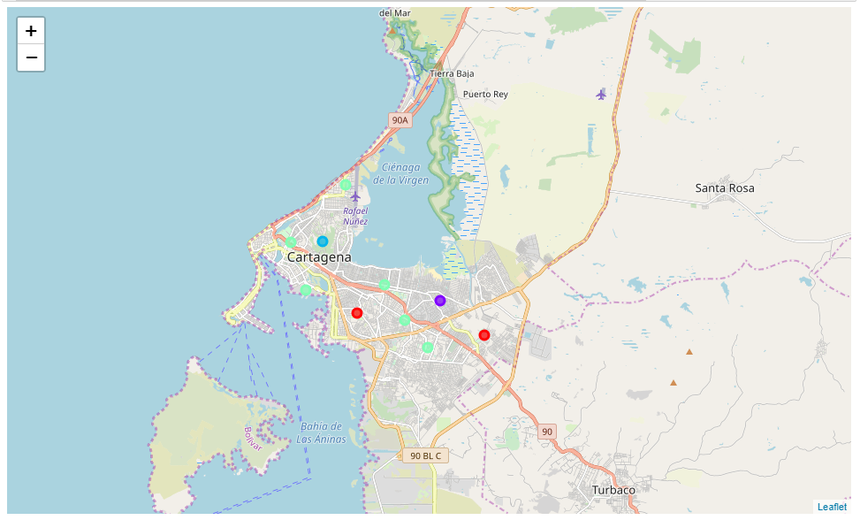
RESULT MAPS - CLUSTERING
BOGOTA
CARTAGENA

Slide 7
CONCLUSION
So, the conclusion to our freelancer Colombian is, if he decides to live in Bogotá:
We recommend the "LOCALIDAD SUBA" Neighborhood because its has 3 of the 4 requirements in 2 distinct places.
In "LOCALIDAD BOSA" there are two places with Restaurants Vegetarian or Vegan, but is most common the bars, so if he likes the drink and the dance, we recommend this Neighborhood.
And the most common venue in most of the Neighborhoods in Bogota is the Fast Food Restaurants.
If he decides to live in Cartagena:
In Cartagena there are not Neighborhoods with the special facilities, because it is a coast city and its first product is the fish, so the major of the venues are restaurants but no vegan or vegetarian.
In Cartagena there are not many parks so, if he needs do physic exercise, he would have to swim in the beach.

